Slide 1
Classifying insincere content in Social Media Posts
By
Kumuda B G Murthy
Raghava D Urs
Shiv Kumar Ganesh

Slide 2
Significance to the real world
The veracity of data has become an existential problem with the volume of data available and generated each day. Almost all of the online platforms are dealing with this. Inaccurate text, misrepresentation of information, and demeaning content have become commonplace on the internet. Social media such as Twitter, Facebook, Quora, etc. are facing this problem and have been constantly fighting it. These forums are being used by millions of people and monitoring such forums requires sophisticated algorithms in work.

Slide 3
Big Data and Tools Used
Data Size : 1.6 Million+ unique questions gathered from Quora
Tools Used : Python, Google Collab, Streamlit
Veracity : Quora questions publicly made available via kaggle.
Variety : Semi structured data.
Volume : 1.6 Million+ unique Quora questions.

Slide 4
Code and Version Control
Packages : Pandas, NumPy, Seaborn, Matplotlib, Sklearn, Itertools, Gensim, Joblib
Predictors : Question text transformed to tfidf vectors
Prediction : Whether question is insincere or not
ML Model : Logistic Regression, Multinomial Naïve Bayes, Support Vector Machine, Decision Tree, Random Forest, Passive Aggressive Classifier
Version Ctrl : GitHub
Google Collab : Collab
Notes:
, Rndom Forest

Slide 5
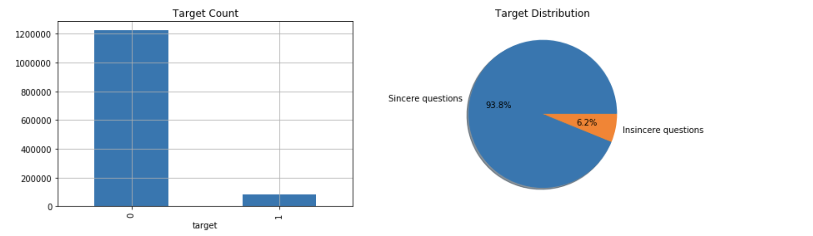
Exploratory Data Analysis

Slide 6
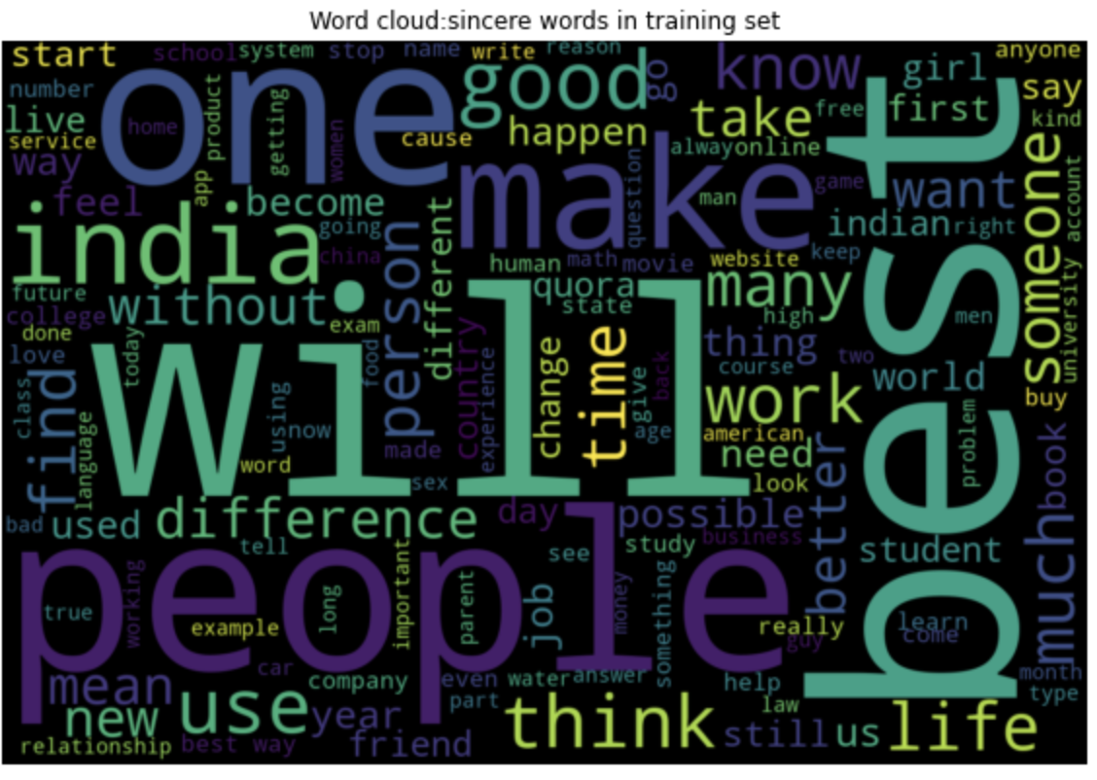
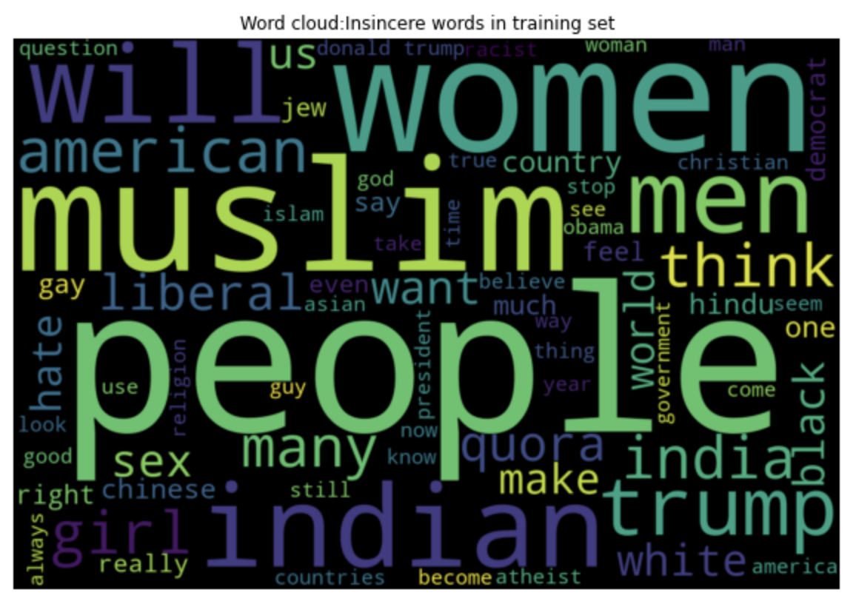
Exploratory Data Analysis

Slide 7
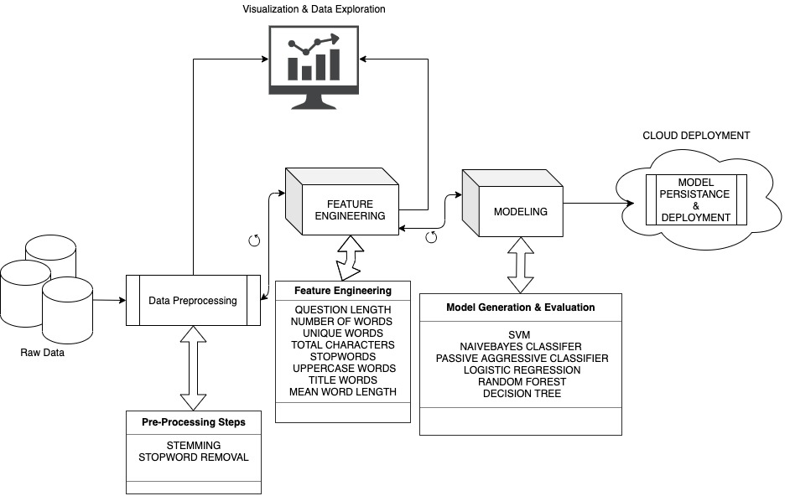
System Architecture

Slide 8
Performance Evaluation
Model Type | Accuracy | Precision | Recall | F1-Score
Multinomial Naïve Bayes | 0.94 | 0.79 | 0.53 | 0.53
Logistic Regression | 0.95 | 0.82 | 0.68 | 0.72
Passive Aggressive Classifier | 0.94 | 0.76 | 0.73 | 0.74
Linear SVC | 0.95 | 0.82 | 0.69 | 0.74
Decision Tree | 0.94 | 0.72 | 0.69 | 0.70
Random Forest | 0.94 | 0.47 | 0.50 | 0.48

Slide 9
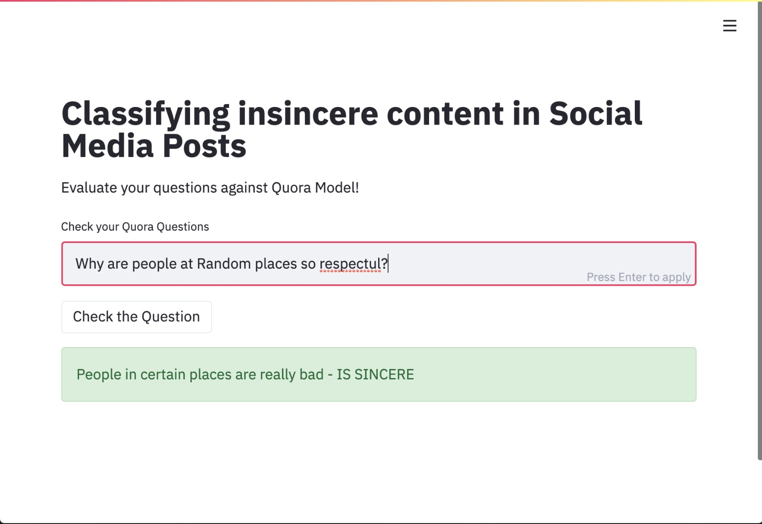
Model Deployment
With each of the above model being generated we also take care of persisting the model file as serialized object on local system or on cloud.
We are using JobLib package to persist eh model in learning phase and consume the mode during testing phase.
Model can be hosted as serverless service which can be accessible over the internet.
Model can also be exposed as REST API hooked with the service which can be consumed either by website or any mobile platform.

Slide 10
Technical Difficulty and Innovation
- The data was heavily imbalanced and multiple methods are tried in order to balance out the data for the classification task - Due to large dataset, we had to employ distributed computing during feature engineering phase - Model selection and evaluation were also difficult owing to the nature of the data, better results could have been obtained using deep learning models.

Slide 11
Publication and Lesson Learnt
Planning to submit for IEEE conference Lessons learnt
- The most crucial phase of the project is feature engineering. - Data gathered is never perfect, have to clean and process before consumption. - No free lunch theorem is real.

Slide 12
Team Work
We followed agile methodology for project management and its execution. We met as a team daily at 4PM.

Slide 13
Q & A

Slide 14
Thank You

Slide 15
Team Work
Step | Task | Assignee | Status | Expected date | Completion date
1. | Project idea brainstorming | Kumuda, Raghava, Shiv | Completed | 9/7/20 | 9/8/20
2. | Project idea finalization | Kumuda, Raghava, Shiv | Completed | 9/10/20 | 9/10/20
3. | Literature survey | Kumuda, Raghava, Shiv | Completed | 9/15/20 | 9/15/20
4. | Project proposal | Kumuda, Raghava, Shiv | Completed | 9/23/20 | 9/25/20
5. | Project Setup | Shiv, Raghava | Completed | 9/30/20 | 9/30/20
6. | Data research and procuring available data sets | Raghava, Shiv | Completed | 5/10/20 | 10/7/20
7. | Data analysis to review the procured data set and identify the useful attributes | Shiv, Kumuda | Completed | 10/10/20 | 10/14/20
8. | Perform EDA to evaluate the data | Raghava, Shiv | Completed | 10/10/20 | 10/14/20
9. | Data pre-processing to remove duplicates, handle null values and incorrect data format | Kumuda, Raghava | Completed | 10/14/20 | 10/22/20
10. | Feature engineering to finalize the attribute set | Kumuda, Raghava | Completed | 10/23/20 | 11/1/20
11. | Model implementation and analysis – SVM | Shiv | Completed | 11/02/20 | 11/24/20
12. | Model implementation and analysis – Decision tree | Kumuda | Completed | 11/02/20 | 11/24/20
13. | Model implementation and analysis – Random forest | Raghava | Completed | 11/02/20 | 11/24/20
14. | Model evaluation – Evaluate the models obtained from previous step and use the model with highest accuracy for prediction | Kumuda, Raghava, Shiv | Completed | 11/22/20 | 11/25/20
15. | Data visualization – Provide a simple UI/form to accept test data and predict. | Kumuda, Shiv | Completed | 11/25/20 | 11/28/20
16. | Project report | Raghava, Shiv | Completed | 11/28/20 | 12/1/20
17. | Project demo and presentation | Raghava, Shiv, Kumuda | Completed | 12/1/20 | 12/1/20

Slide 16
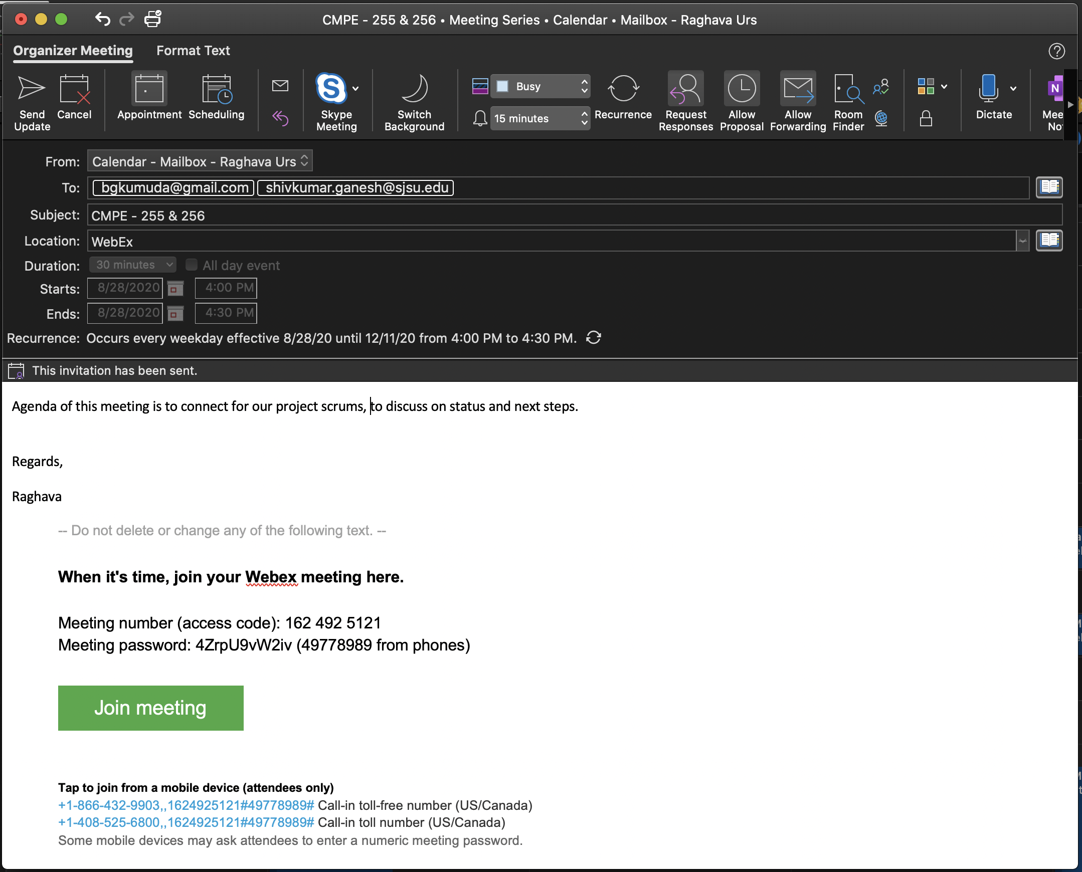
Scrum meeting details

